Slide 1
An Immovable Object Meets an Unstoppable Force: Does Defense Produce Success in Football?
Kyle Tan

Slide 2

Agenda
Introduction
Literature Review
Methodology:
Preprocessing
Feature Selection + Analysis
Model Building + Analysis
Conclusion
Recommendations
Questions

Slide 3
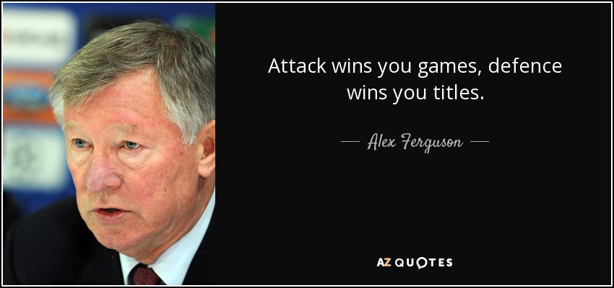
Introduction
“Attack wins Games, Defense wins titles.”
Common rhetoric in all sports.
With changing world of football, does this quote hold true?
Aim to answer this question by looking at the predictive ability of defensive stats on a team’s predicted chances of winning.
Does emphasizing, focusing and investing into defense really win more?
Defense is defined by a team that will look to sit back in their own side, allow the opposition to be on the ball. The aim is not to create but rather not allow the opposition to score.
Low build ups speeds.
High defensive aggression.
Low team width.
Less expressiveness.

Slide 4
Literature Review
What do I already know?
Purely rhetoric, no data based knowledge.
Balance is key.
What do you have to say critically about that is already known?
Research is new, very niche, and not vastly developed.
Mostly focused on attacking side.
No consensus on what defines “defense”. Unlike attack.
Has anyone else ever done anything exactly the same?
No
Has anyone else done anything that is related?
Yes, there is a lot of predictive modelling for stats like offense, injuries, values, etc. All are very specific.
Most work is not comparative.
Where does your work fit in with what has gone before?
Aims to further develop knowledge in defense.
Why is your research worth doing in the light of what’s already done?
Not a lot of work has been done in defensive side of the game.
Aims to expand on existing knowledge taking inspiration from previously used techniques to help further develop understanding on the defensive game.

Slide 5
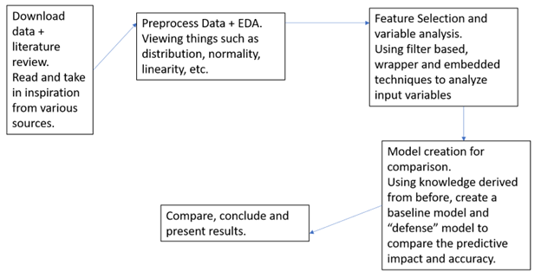
Methodology – General Road Map

Slide 6
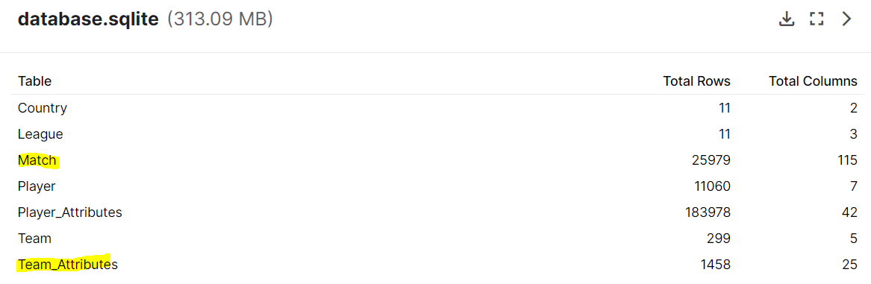
Methodology – Pre-Processing: Base Data Details
Dataset taken from Kaggle:
https://www.kaggle.com/datasets/hugomathien/soccer?datasetId=63&sortBy=voteCount
Only relevant data frames are kept:
Subset for generally accepted “top divisions” only (England, France, Germany, Italy, Spain).
Subset and merge frames to show only home wins.
“Match” table provides the output betting odds of matches
“Team_Attributes” table provides the input team variables.
Contains categorical and numerical input variables.
Once subset and merging is done, a data frame of just numerical variables is created alongside one for solely categorical input variables.
Team attributes are transcribed from the popular video game, FIFA (most up to date version) as per sofifa.com

Slide 7
Methodology – Pre-Processing: Defining
Defense is defined by a team that will look to sit back in their own side, allow the opposition to be on the ball. The aim is not to create but rather not allow the opposition to score.
Low build ups speeds.
High defensive aggression.
Low team width.
Less emphasis on build up play.
Non-Defensive Play in the context of this project is simply the input variables with the defensive variables removed.
Success is defined the average available betting odds.
Low returns/odds = favorable match for the home team. As generally, the higher the returns are, the more unlikely the bet is likely to happen. Low odds represent relative stability, guarantee, and favorability.

Slide 8
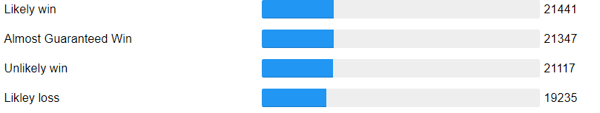
Methodology – Pre-Processing: Output Variable
How the final output variable is derived:
EDA report shows a few betting companies with huge missing values.
Threshold: < 1 %. Else removed.
Data loss ignorable (< 1%).
An average is taken between the remaining betting company. The average will represent the consensus on possible results amongst betting companies.
Outlier removal is done.
Threshold: within 3 z-scores of average.
Data loss ignorable (< 3%)
Conversion of continuous data to categories for algorithms.
Categories are created based on IQR.
Categories are evenly distributed.
Attribute Name | Missing Values
B365H | 0.1%
BWH | 0.2%
IWH | 0.3%
LBH | 0.01%
PSH | 50%
WHH | 0.01%
SJH | 24.1%
VCH | 0.2%
GBH | 37.7%
BSH | 37.7%
Categories | Ranges | Numerical Variable
Almost Guaranteed Win | 0 – 1.682 | 1
Likely Win | 1.683 – 2.100 | 2
Unlikely Win | 2.101 – 2.684 | 3
Likely loss | 2.684 + | 4
5. Converting string categories into numerical.
Some algorithms refuses all string inputs.
As such a set of numbers as variables is created to represent each of the categories so it can put into certain algorithms.

Slide 9
Methodology – Pre-Processing: Output Variable
How the final output variable is derived:
5. Converting string categories into numerical.
Some algorithms refuses all string inputs.
As such a set of numbers as variables is created to represent each of the categories so it can put into certain algorithms.
Shapiro Wilkes was performed on the output variable.
Cannot assume normality.
Non-parametric options will be considered.
Categories | Ranges | Numerical Variable
Almost Guaranteed Win | 0 – 1.682 | 1
Likely Win | 1.683 – 2.100 | 2
Unlikely Win | 2.101 – 2.684 | 3
Likely loss | 2.684 + | 4

Slide 10
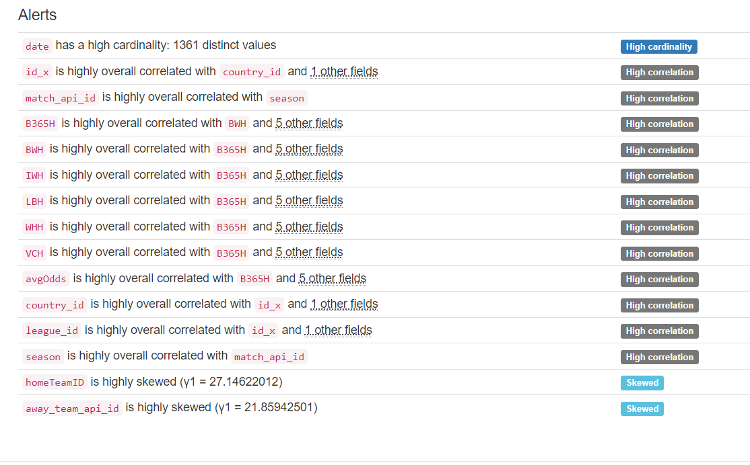
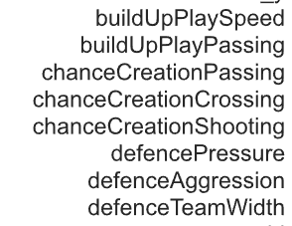
Methodology – Pre-Processing: Input Variable I
Numerical Data:
Input Variables:
EDA report shows all warnings are not for the input variables.
No outliers, no missing data.
No standardization needed as the values are all already on a common scale of 1 - 100

Slide 11
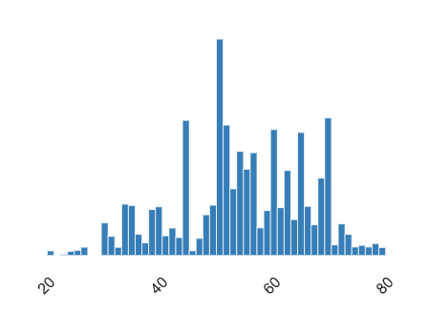
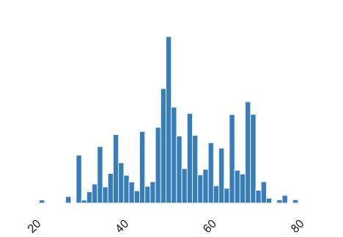
Methodology – Pre-Processing: Input Variable I
Numerical Data:
The graphs = random samples of distribution graphs of input numerical variables from EDA.
Upon looking at all the graphs, normality of the input variables can be assumed.

Slide 12
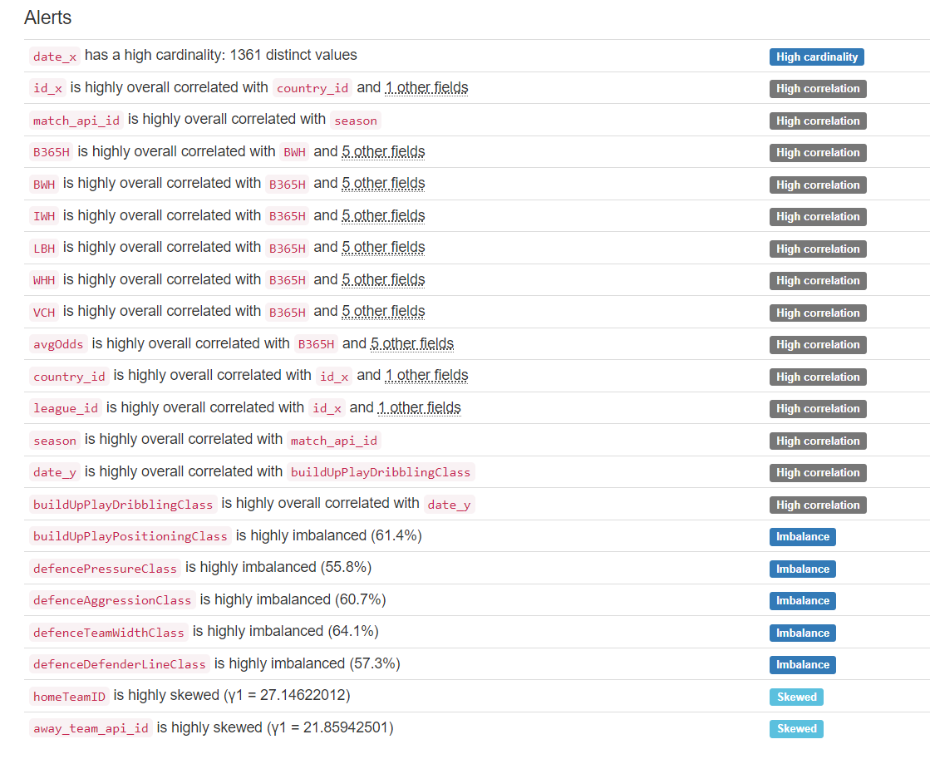
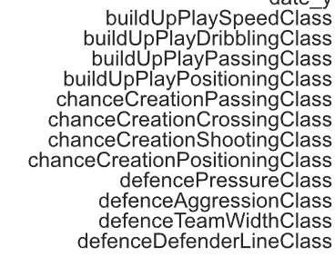
Methodology – Pre-Processing: Input Variable II
Categorical Data:
Input Variables:
This time, EDA report shows lots of cases of imbalance.
Same to numerical data, no outlier, no missing values, no standardization needed.

Slide 13
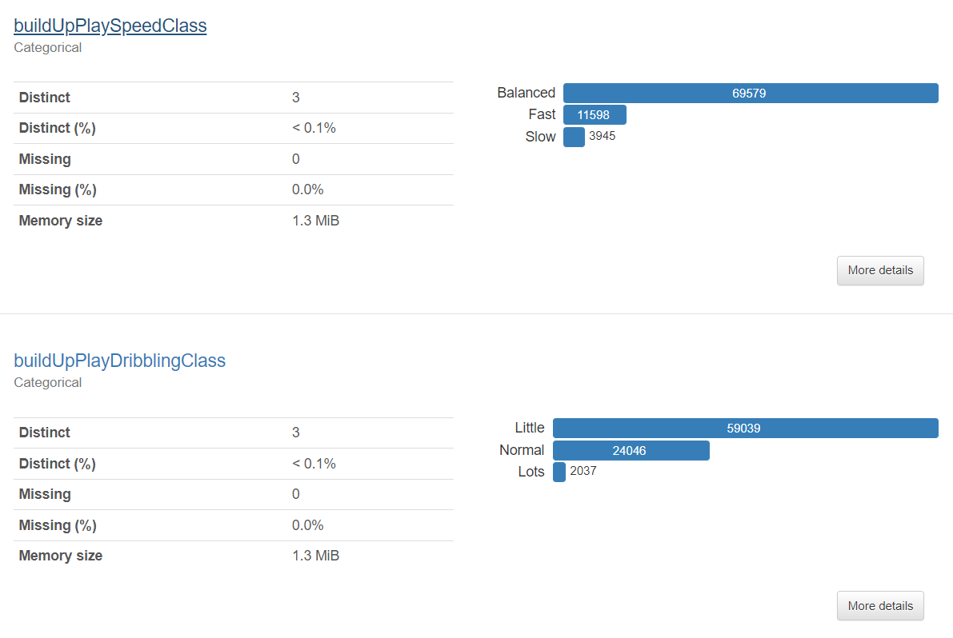
Methodology – Pre-Processing: Input Variable II
Categorical Data:
This time, EDA report shows lots of cases of imbalance.
The same random sampling of distribution is done for categorical data.
Distributions show very large degrees of skew, normality cannot be assumed.

Slide 14
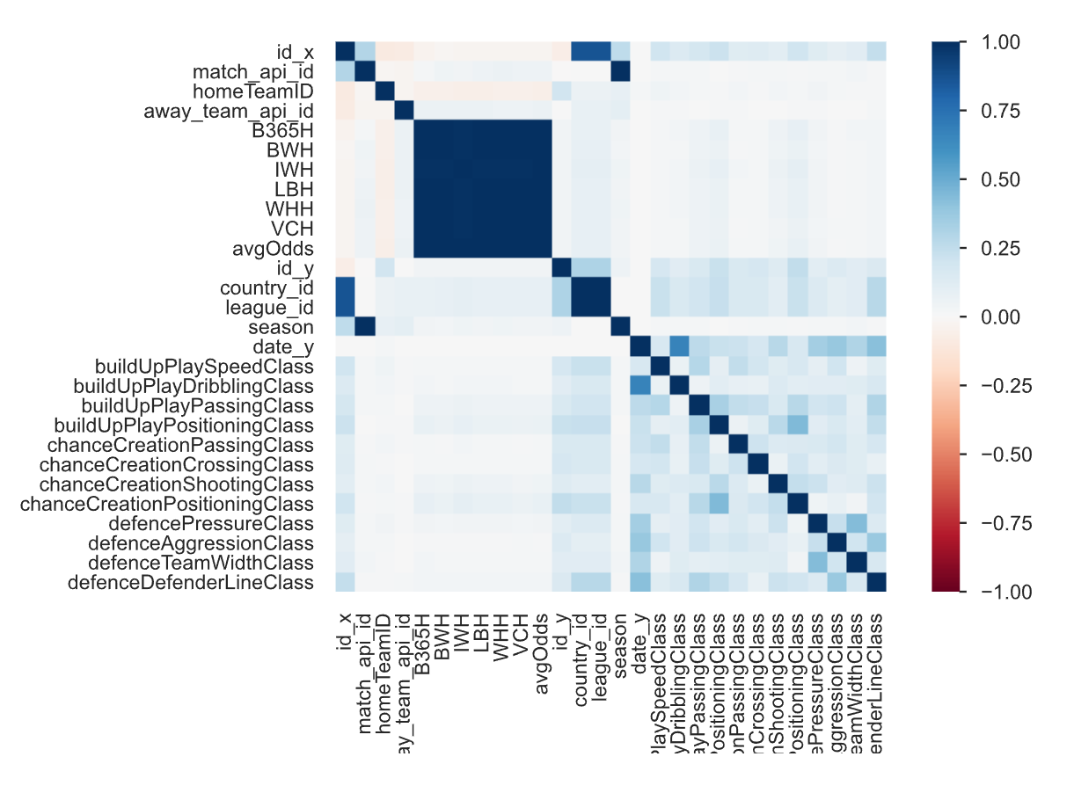
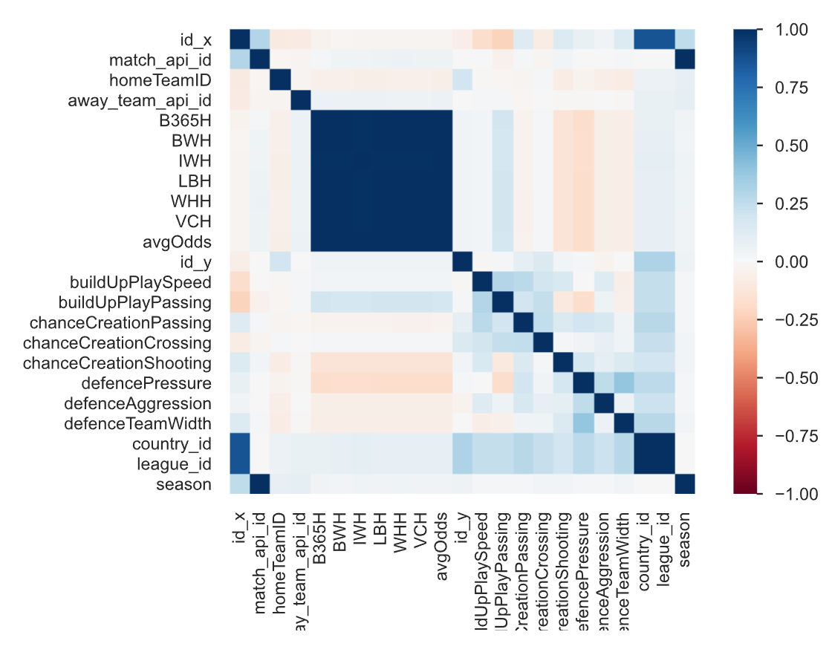
Methodology – Pre-Processing: Input Variable III
Both Datasets:
Upon further look on multicollinearity.
Amongst themselves, in their own data frames, the categorical inputs and the numerical inputs do no correlate to each other.
We can see from their respective interactions chart, that only irrelevant variables are highly correlated.
Not much of the input variables raises cause of concern.
The two data frames are then put into one data frame to do further analysis.
This is where some problems arise.

Slide 15
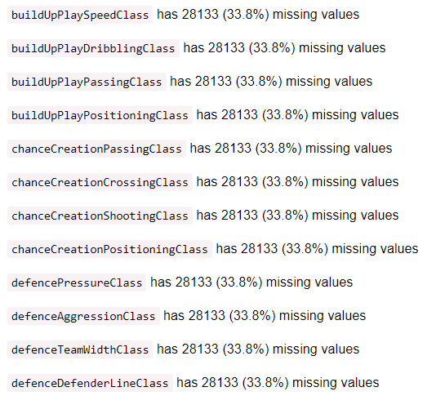
Methodology – Pre-Processing: Input Variable III
Both Datasets:
Issue 1: Missing Data
New EDA on the combined data frame shows categorical data is missing 33.8% of the data.

Slide 16
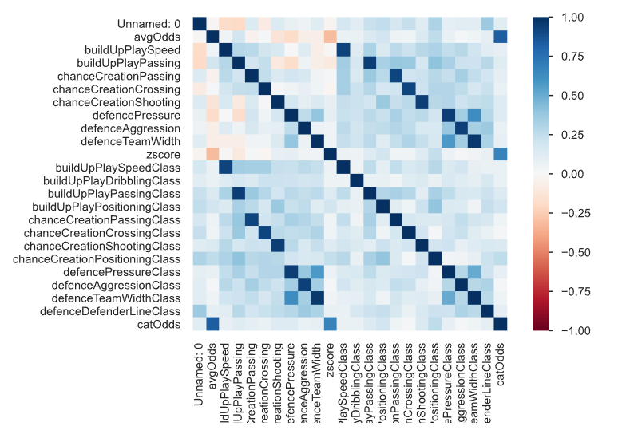
Methodology – Pre-Processing: Input Variable III
Both Datasets:
Issue 2: Highly Correlated Data
New EDA on the combined data frame shows categorical data is very coincidentally correlated to the numerical data.
Except for:
buildUpPlayDribblingClass
chanceCreationPositionClass
defenceDefenderLineClass
Almost as if they’re mirrors of each other.
That’s because they are.
From looking back at Kaggle and the raw data. It’s evident the categories are derived based on numerical data.
Solution:
Categorical data will simply be dropped, as it doesn’t ‘add’ anything.
High missing data and repetitive, correlated data makes the information derived here fairly irrelevant.

Slide 17
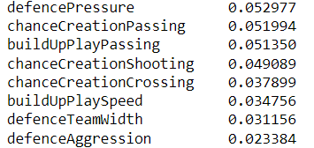
Methodology – Feature Selection I
Filter Based – Information Gain:
Using just a rank and sort filter the following ranking is generated:
Info Gain = measure of the reduction in entropy/surprise/randomness for each variable.
Higher = better. Scale of 0 – 1.
Analysis:
Results are objectively low (highest is ~0.53).
Relatively speaking, only defense pressure is up there. The other defensive stats, are relatively low in information gain, representing high amount of randomness.
Overall takeaway: all predications (defense based or not) are going to be fairly inaccurate. There is a difference in the influence of defensive variables, but this is very little.

Slide 18
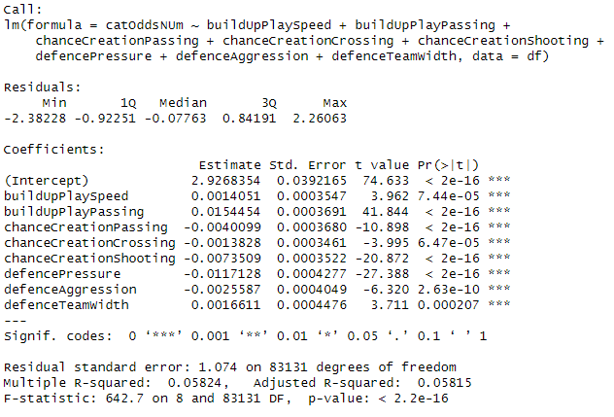
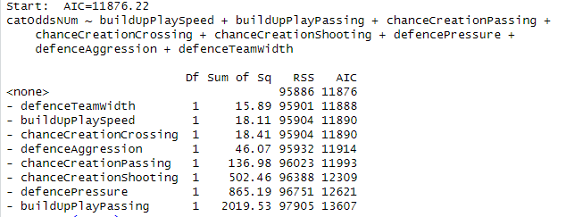
Methodology – Feature Selection II
Wrapper Based – Backwards selection
Numerical variables for the output variable was used, as R did not accept string as output variable.
AIC – Akaike Info Criterion: estimator of prediction error. A measure of how well the model fits the data.
Lower the better = lower amounts of info loss.
Rsquared – similarly, this is a corrected measure of model accuracy.
Scale of 0 – 1, closer to 1 is better.

Slide 19
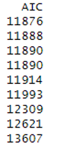
Methodology – Feature Selection II
Wrapper Based – Backwards selection – key takeaways.
AIC showing the strongest variables at the top.
Note, relatively, the range is not that very big. Meaning the power of each variable doesn’t vary too much.
Objectively, the AIC is very high.
Interesting to note top AIC is a defensive measure.
AIC – Akaike Info Criterion: estimator of prediction error. A measure of how well the model fits the data.
Lower the better
Adjusted Rsquared – similarly, this is a corrected measure of model accuracy.
Scale of 0 – 1, closer to 1 is better.
Adjusted R-squared is not good. A value of ~ 6 % is objectively low on the scale.
Model won’t be very accurate.
Agreement with takeaways from info gain: low predictability overall, each variable has influence, but little.

Slide 20
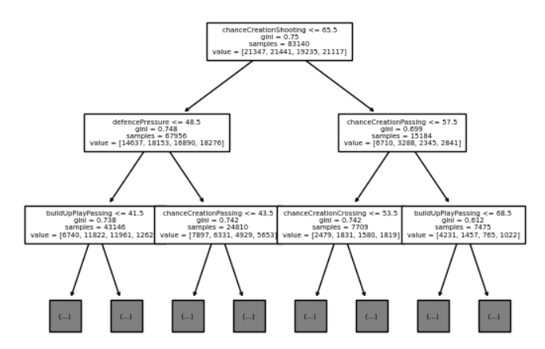
Methodology – Feature Selection III
Embedded Method – Decision Tree
Tree Parameters:
GINI based – split so that the next node is as pure as possible. Top of tree = variable that helps create the purest resulting splits subsequently.
Seed = 88.
Max depth = 3.
70:30 testing:training. (holdout method)
This is kept consistent for all trees built
GINI – calculates the probability that a feature is classified incorrectly.
0 = all elements belong to a certain class.
1 = elements are randomly distributed across various classes.
Ideally, we want to minimize.
Tree is abridged as for the scope of the project; we care about the most influential variables a.k.a the items at the top.
Irrelevant branches below are trimmed to reduce mess.
If we do look at the rest of the tree we can see that GINI doesn’t get that low.
Takeaways: one of the top influencers, again, is defencePressure. Just like what the previous feature selections have told us. The models won’t be accurate.

Slide 21
Methodology – Feature Selection IV
Bonus Recommended Method – SelectKBest
Chi-Squared Test – measure dependence between variables.
Weeds out the features that independent of the class.
As we have determined non-parametric is appropriate, the chi-squared test is used for the K select.
Originally K = 3, but it was expanded to 6 to look further.
chanceCreationPassing
chanceCreationShooting
defencePressure
buildUpPlayPassing
defenceTeamWidth
defenceAggression
Takeaway: defencePressure shows up again as a top influencer input variable. However, the top is still predominately non-defense variables.

Slide 22
Methodology – Feature Selection: Analysis
General Takeaway:
DefencePressure is the only defensive input variable that is consistently showing up.
Whatever model we create, it will be an inaccurate model. Regardless of whether it is defense based or not.
The key will be looking at the relative differences.
Objectively, this topic is not well predicted.
The feature selections have also told me, the input variables do work together to influence the output, however, their influences are not strong.
This tells me, defense is a part of the puzzle, but not the main piece. Nothing is the main piece; all pieces are fairly relevant and key.

Slide 23
Methodology – Model Building
To look at relative differences between models, I will build 9 models:
Decision Tree
Random Forest
KNN
Each of the techniques above will be used with respect to each of the following parameters:
Defensive Model
Non-Defensive Model
Baseline
Recall: defensive model is simply one that includes solely defencePressure, defenceTeamWidth, and defenceAggression, baseline is all input variables included, and non-defensive is simply baseline – defensive.

Slide 24
Methodology – Model Building: Definitions
For the scope of this project the following are defined for accuracy measures:
Term | Definition in the Scope of This Project
Accuracy | = # of correct predictions / total # of predictions
Positive/Negative Outcome | (Positive is) The prediction class in question, relative to what we want. E.g. If want to look for Guaranteed Wins, then this is the positive outcome, all other outcomes are considered negative.
True Positive (TP) | Outcome where the model correctly predicts the positive outcome.
False Positive (FP) | Outcome where the model incorrectly predicts the positive outcome.
True Negative (TN) | Outcome where the model correctly predicts the negative outcome.
False Negative (FN) | Outcome where the model incorrectly predicts the negative outcome.
Precision | What proportion of “positive” classification was actually correct. = TP / (TP + FP) Tells us what % of the prediction for the positive outcome is correct. E.g. if Precision for “Likely Win” = 50% then, when the model predicts a point to “Likely Win”, it’s correct 50% of the time.
Recall | What proportion of actual positives was identified correctly, = TP / (TP + FN) Tells us how much of an outcome class if correctly identified. E.g. if Recall for “Likely Win” is 75%, then it correctly identifies a point as “Likely Win” 75% of the time.
F1-Score | Harmonic mean of the precision and recall. It’s a measure of the model’s accuracy that’s able to capture the nuances of the different types of error that may occur. = TP / (TP + 1/2[FP + FN])
Support | Number of “TRUE” responses that lie in each of the class variables. Number of points that’s classified as each output variable.

Slide 25
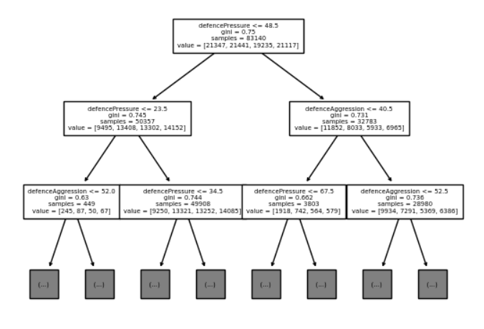
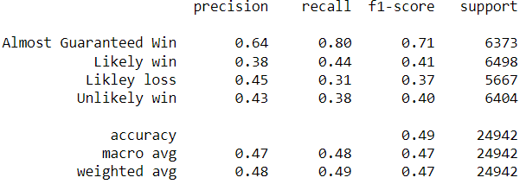
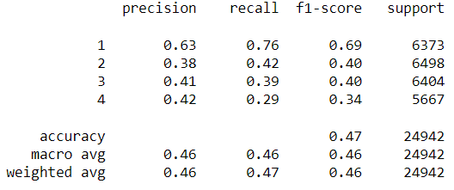
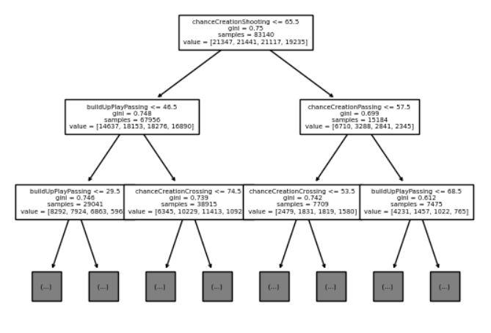
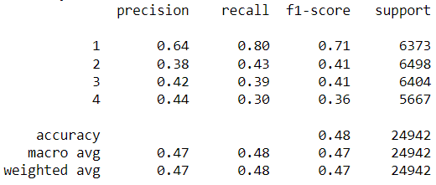
RECALL: Tree Parameters:
GINI based
Seed = 88.
Max depth = 3.
70:30 testing:training.
Methodology – Model Building I
Baseline
Defensive
Non-Defensive

Slide 26
Methodology – Model Building I
For the decision tree models, the accuracy stats can be summarized below:
Model | Accuracy Score | Efficiency (secs)
Defensive | 0.469 | 1.19
Non-Defensive | 0.485 | 1.26
Baseline | 0.485 | 0.49
RECALL: Tree Parameters:
GINI based
Seed = 88.
Max depth = 3.
70:30 testing:training.
Takeaway:
Defense is lower than the other models.
Although, relatively, the difference is low.
This tells me defense has a say, but it’s not the strongest influencer.
Accuracy of an average of 47% is not good.
All models have fairly high GINI.

Slide 27
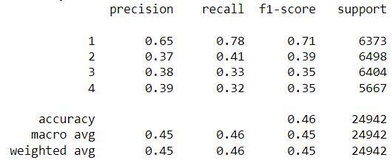
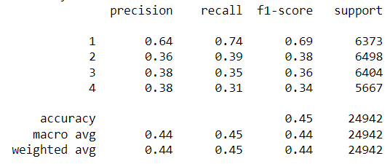
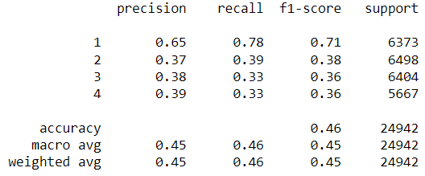
Methodology – Model Building II
Random Forest
For random forest, the ‘numerical variables’ were employed again as algorithm did not take string input.
Parameters are kept default for consistency:
100 trees, GINI based split, no pruning.
Accuracy Scores and stats and presented below:
Baseline
Model | Accuracy Score | Efficiency (secs)
Defensive | 0.4510 | 2.18
Non-Defensive | 0.4625 | 3.27
Baseline | 0.4624 | 3.18
Defensive
Takeaway:
Once again, defensive model is relatively lower than the other models, but not by much.
Interestingly, we can see the accuracy of the non-defensive model improve by 0.0001 when defensive variables are removed. It’s interesting to note, but the adjust is so little it’s negligible.
The accuracies for this model is, again, pretty low, at about 46%.
Non-defensive

Slide 28
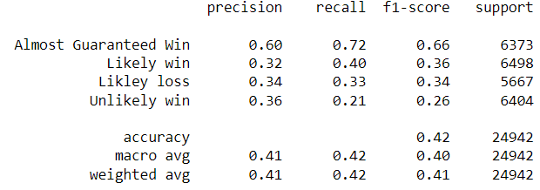
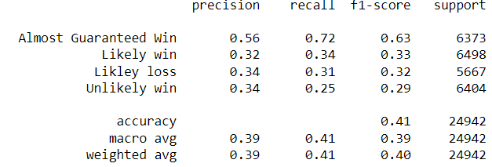
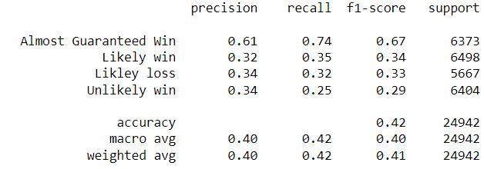
Methodology – Model Building III
KNN
Where k = 5 for all models.
Accuracy Scores and stats and presented below:
Baseline
Model | Accuracy Score | Efficiency (secs)
Defensive | 0.4078 | 1.49
Non-Defensive | 0.4176 | 1.56
Baseline | 0.4183 | 1.67
Takeaway:
For the third time, the defensive model shows the lowest accuracy.
Unlike in Random Forest, non-defensive did not improve this time when the defensive variables are removed. Again, the change is so small it’s ignorable.
KNN produced the lowest accuracies amongst all 3 techniques at an average of about 41%.
Defensive
Non-defensive

Slide 29
Methodology – Conclusion + Analysis
The accuracy scores of all 9 models are summarized below:
Efficient detail was included but not discussed as it was a requirement of the assignment, but not relevant to the topic of this project. Decision tree is most efficient, however.
 | Decision Tree | Random Forest | KNN
Defensive Model | 0.469 | 0.4510 | 0.4078
Non-Defensive Model | 0.485 | 0.4625 | 0.4176
Baseline Model | 0.485 | 0.4624 | 0.4183
We can see here, relatively, the baseline model and non-defensive model outperformed the solely defensive model every time.

Slide 30
Methodology – Conclusion + Analysis
Looking back at feature selection and the details generated from model building we can conclude:
Defense does not win titles.
Defense is only 1 of multiple factors that influences success, solely focusing on defense or any one aspect of the game is foolish. Although, success is not guaranteed, a team needs to focus on everything, as everything input variable has a similarly weak, but fair say.
From Model Building:
The models that focus on everything or solely non-defensive variables outperforms the defensive model every time.
Difference with defense removed is tiny on the objective scale.
Success is never guaranteed, as prediction accuracy is low.

Slide 31
Methodology – Conclusion + Analysis
From Feature Selection:
Objectively high AIC that are not too widely ranged (numbers are fairly close to each other) from backwards selection, tells me the input variables are similar in their influencing abilities.
That is: not too strong.
From information gain, the values for each input variable are, once again, similar, but super low.
Again, this says they have similar influential powers, which is not that much.
The low adjusted-rsquared tells me the results are not guaranteed, as accuracies are low.
The high and not too ranged GINI values on the decision trees tells a similar story to AIC and info gain.
The only defensive variable to consistent show up on the top of feature selection is defensivePressure. The other defensive variables consistently appear low in feature selection lists.
Tells me defensive inputs are not the top influencers compared to the non-defensive.
Again, defense does not win titles. Victory is multi-faceted and not 1D.

Slide 32
Methodology – Limitations & Recommendations
Limitation & Critical Insight:
Skill + knowledge limitation.
Time and resources limitation.
Bias of source data:
Team attributes are taken from FIFA. It’s a video game, and as such the numbers are generated with bias. It’s not an objective look at what happens on the pitch, it’s relative to what the experts at Electronic Arts decide.
Betting odds are also biased. It’s not a guarantee of victory, it’s based on experts’ decision making.
Accuracy of models:
The accuracies are not good for all the models created.
With a more seasoned researched, that has more time and resources perhaps a better set of models could be created.
GINI vs entropy splitting.
Better cross validation.
Better input variable selection.

Slide 33
Methodology – Limitations & Recommendations
Limitation & Critical Insight:
Home team bias:
The scope of this project is only with respect to home team wins, which introduces home team bias, as teams tend to have an advantage playing at home as opposed to when travelling.
Top tier bias:
The scope of this project is only the generally accepted “top leagues”.
These leagues are the ones where athletes perform to the top of their game, influences of defense and tactics may be washed down by the professionalism of other aspects of the game.
An analysis on the amateur game could be expanded.
Future continuity:
Collect more in-depth input variables (maybe not from FIFA).
Try other forms of model building to create better accuracies.
Try different model parameters.
A more robust measure of success could be defined.

Slide 34
Thank you! Questions?

Slide 35
Citation of Sources:
Anderson, C., & Sally, D. (2013). The Numbers Gae. Penguin.
Breaking the Lines. (2022, July 28). What is Juego de Posición? Retrieved from Breaking the Lines: https://breakingthelines.com/tactical-analysis/what-is-juego-de-posicion/
Brownell, P. (2013, July 31). Which Stats Are Most Important for Measuring Defenders? Retrieved from Bleacher Report: https://bleacherreport.com/articles/1722602-which-stats-are-most-important-for-measuring-defenders
Ćwiklinski, B., Gielczyk, A., & Choras, M. (2021). Who Will Score? A Machine Learning Approach to Supporting Football Team Building and Transfers. Entropy, 90.
Davis , A., & Suryawanshi, N. (2023, 1 14). Northwestern Sports Analytics Group. Retrieved from Does Defense Win Championships?: https://sites.northwestern.edu/nusportsanalytics/2020/12/15/does-defense-win-championships/
FOX Sports. (2023). FIFA World Cup 2022 Defensive Stats. Retrieved from Fox Sports: https://www.foxsports.com/soccer/morocco-men-team-summary-stats?category=defensive&sort=t_int&season=2022&sortOrder=desc&groupId=12
MARCA. (2012, 9 12). Spain beats its possession record for the Del Bosque era. Retrieved from MARCA: https://www.marca.com/2012/09/12/en/football/national_teams/1347468397.html
Merhej, C., Beal, R., Ramchurn , S., & Matthews, T. (2021). What Happened Next? Using Deep Learning to Value Defensive Actions in Football Event-Data. Proceedings of the 27th ACM SIGKDD Conference on Knowledge Discovery & Data Mining, 3394-3403.
Rossi, A., Pappalardo, L., Cinitia, P., laia , F. M., Fernandez J,, & Medina, D. (2018). Effective injury forecasting in soccer with GPS training data and machine learning. PloS on.
Smith, A. (2017, 8 30). Does attack or defence win titles? Retrieved from Premier League: https://www.premierleague.com/news/464218
Stöckl, M. S. (2021). Making offensive play predictable-using a graph convolutional network to understand defensive performance in soccer. In Proceedings of the 15th MIT Sloan Sports Analytics Conference.
Winterburn, S. (2017, January 7th). What can we learn from defensive statistics? Retrieved from Football3665: https://www.football365.com/news/what-can-we-learn-from-defensive-statistics

